Slide 1

INTERNET OF THINGS
Chapter 6: Application Protocols for IoT
Dr. Nagegowda K S
Department of Computer Science & Engineering

Slide 2
INTERNET OF THINGS
Agenda
The Transport Layers
IoT Application Transport Methods

Slide 3
INTERNET OF THINGS
IoT Application Transport Methods
Application Layer protocol not present
Supervisory control and data acquisition(SCADA)
Generic web-based protocols
IoT application layer protocols

Slide 4
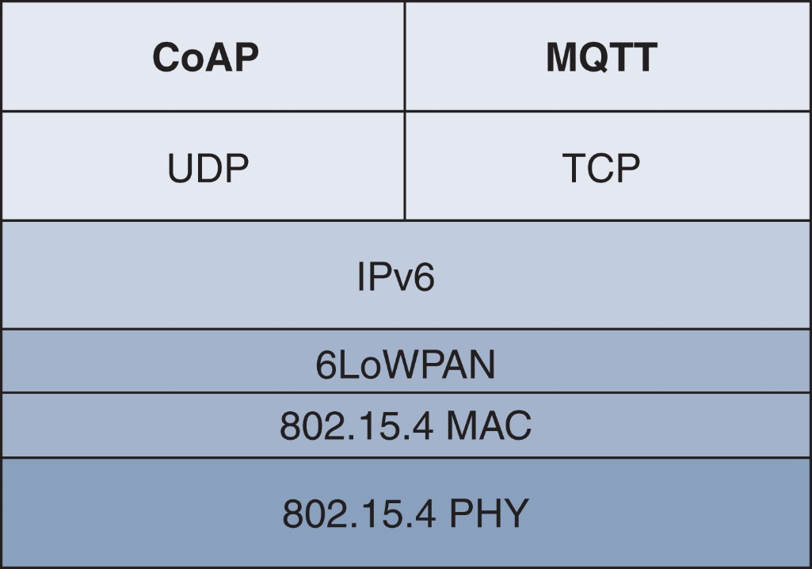
INTERNET OF THINGS
IoT Application Layer Protocols

Slide 5
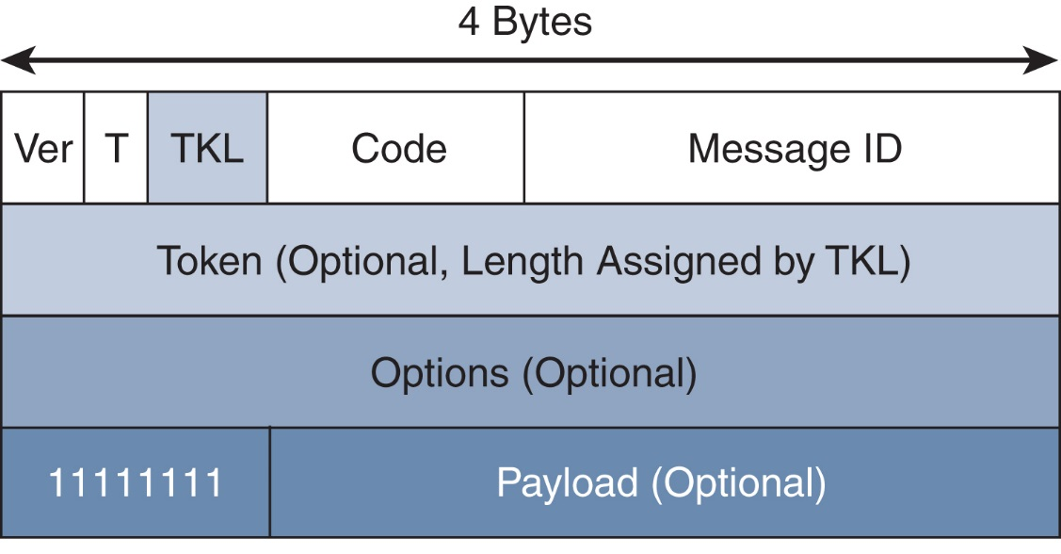
INTERNET OF THINGS
CoAP
Figure - CoAP Message Format

Slide 6
INTERNET OF THINGS
CoAP

Slide 7
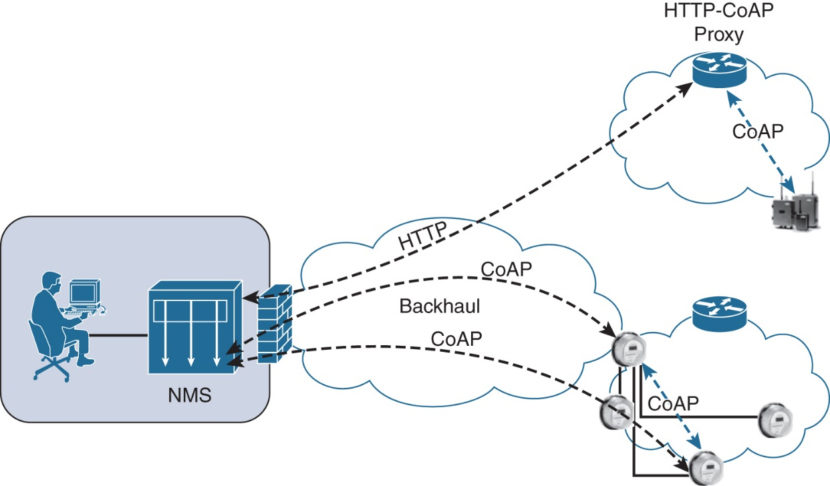
INTERNET OF THINGS
CoAP
Figure - CoAP Communications in IoT Infrastructures

Slide 8
INTERNET OF THINGS
CoAP

Slide 9
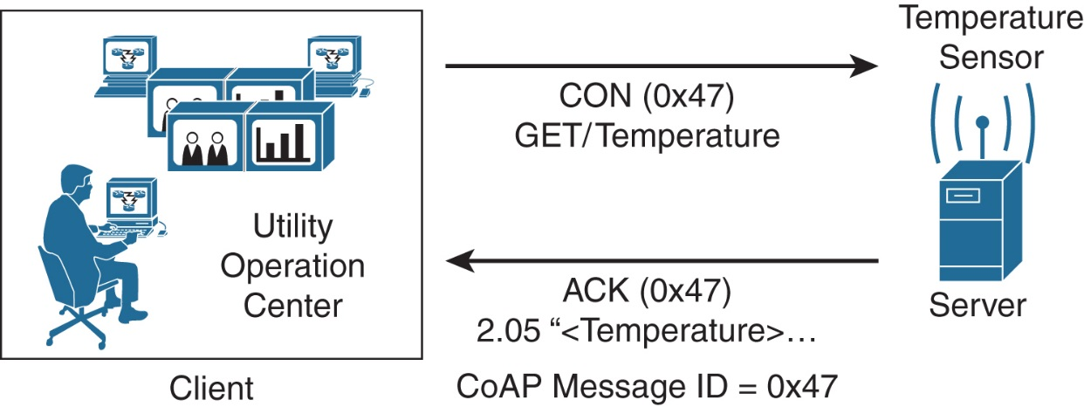
INTERNET OF THINGS
CoAP
Figure - CoAP Reliable Transmission Example

Slide 10

THANK YOU
Dr. Nagegowda K S
Department of Computer Science & Engineering
nagegowda@pes.edu

